Slide 1
工作汇报
2019年7月1日 赵天明

Slide 2
(4) Extract templates from these web pages: cut out all subtrees from the original DOM tree, and use the subtree as index to identify a template. We group all the subtrees with the same structure together, forming a GUI template. (same structure but diﬀerent styles)
A template retriever will retrieve templates in the GUI repository that match the given structure. first segments the PUD into several blocks by dividing the DOM tree into multiple subtrees. The segmentation is based on the structural similarity of subtrees between blocks and GUI templates in the GUI repository. We use a variant of tree edit distance algorithm proposed [15] to define the structural similarity of subtrees.
Adopt a top-down searching algorithm to improve the speed of searching segmentation.

Slide 3
·First, we can find the template in our repository with the least matching gap with the given DOM tree.
·Then, we divide all the children into subtrees, and apply this algorithm recursively to these subtrees.
·If the sum of matching gap of all these subtrees is less than that of the complete tree, we should segment it.
·In this way, we can recursively find out the optimized segmentation to minimize the overall matching gap, and meanwhile retrieve all the templates.

Slide 4
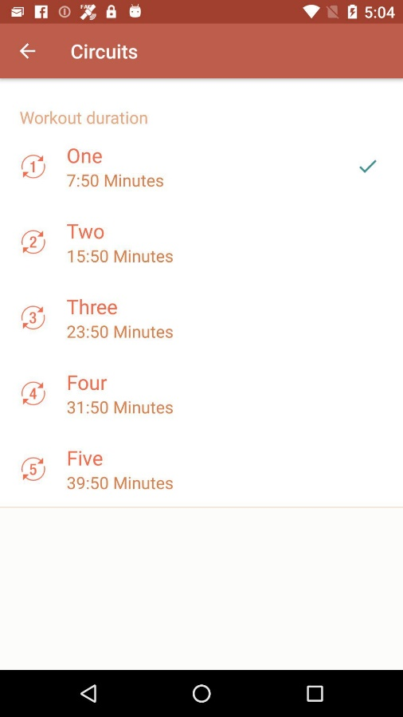
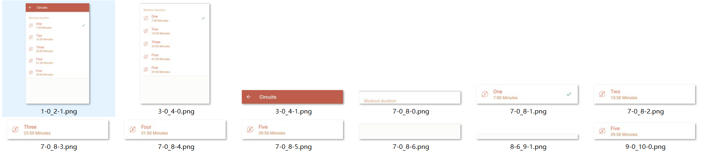
Cases(without same bounds, cut off all leaf nodes, cut off the last second father nodes):

Slide 5

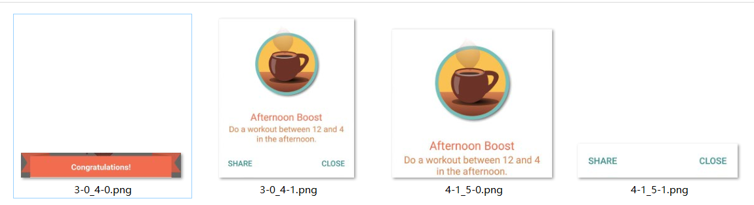

Slide 6

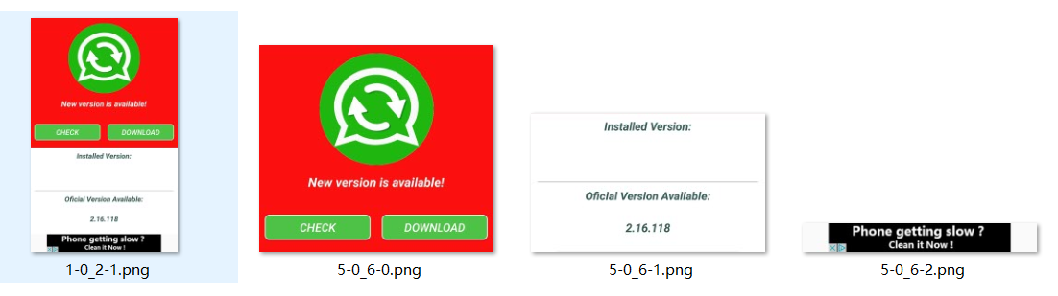

Slide 7



Slide 8
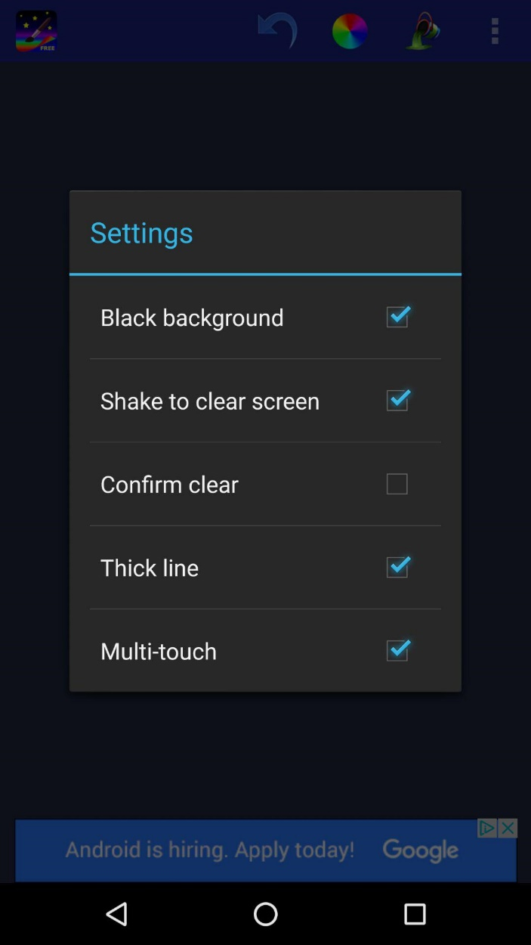
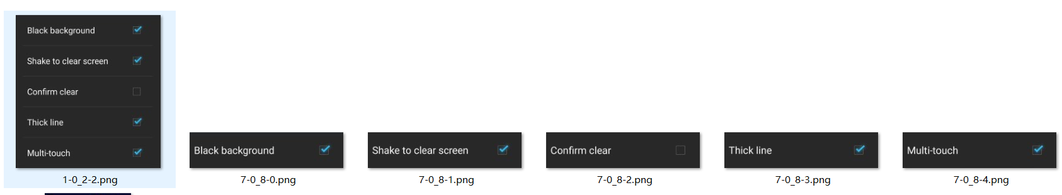

Slide 9
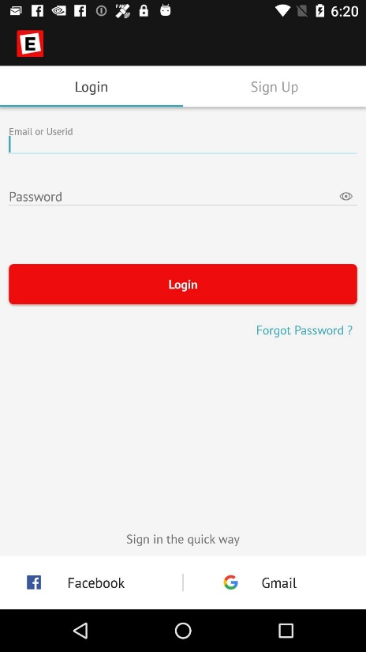
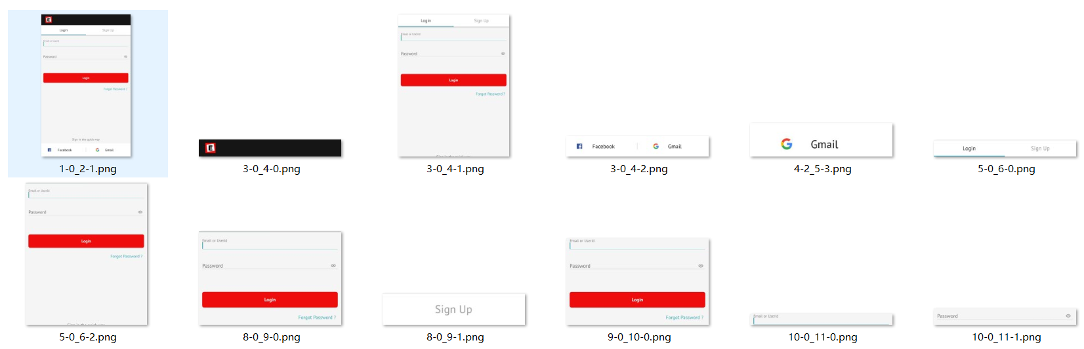

Slide 10
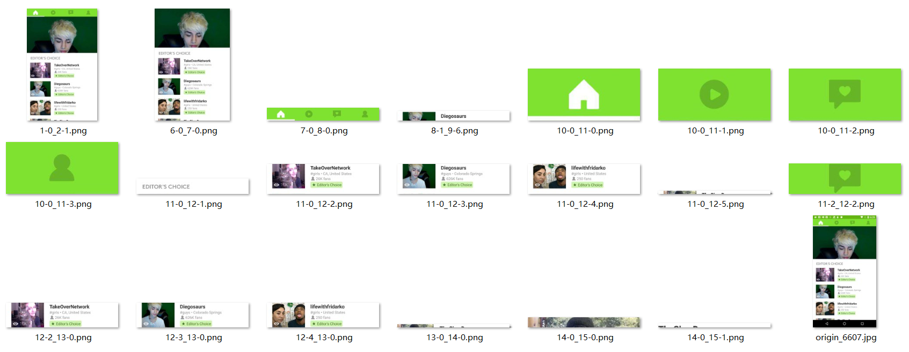

Slide 11
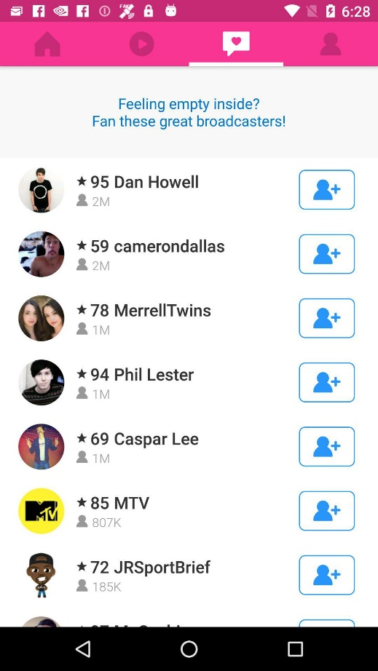
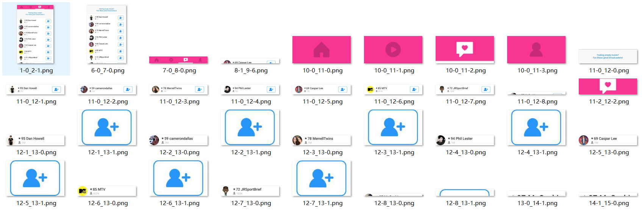

Slide 12

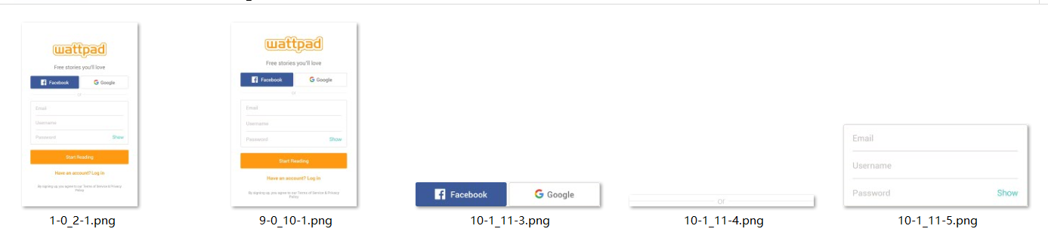

Slide 13
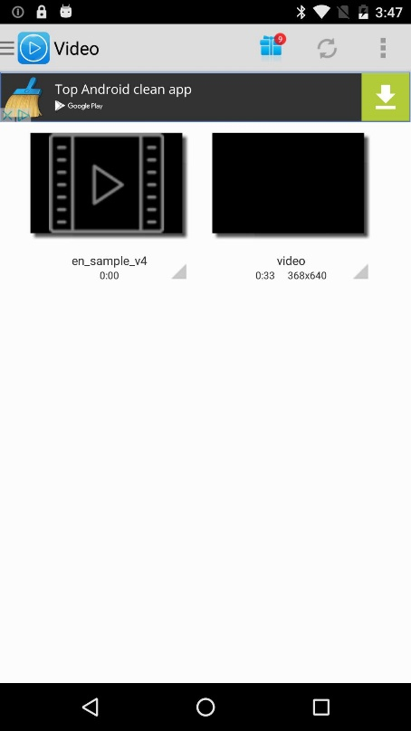
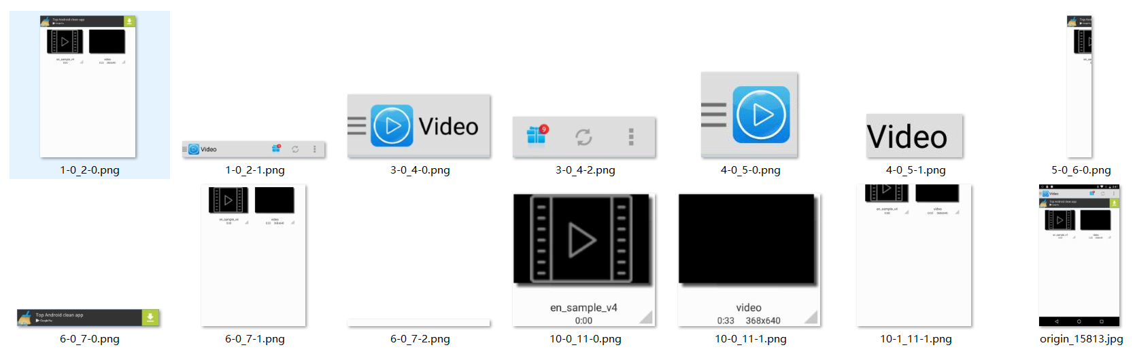

Slide 14
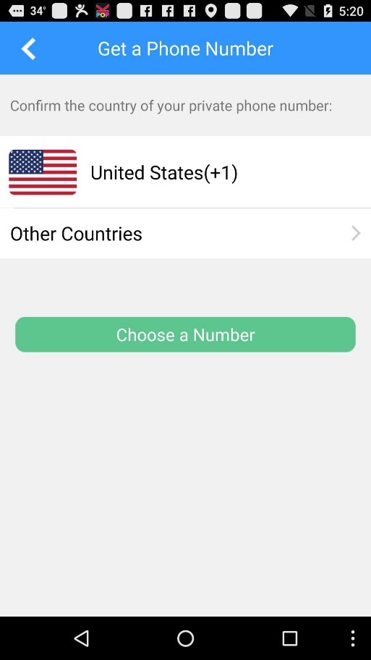
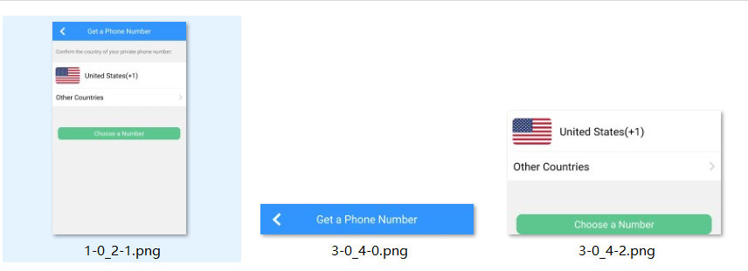

Slide 15
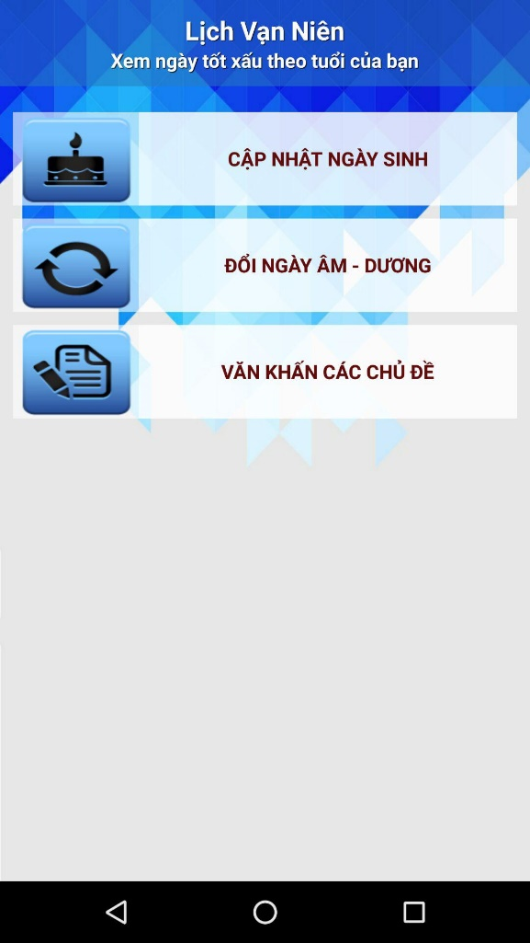
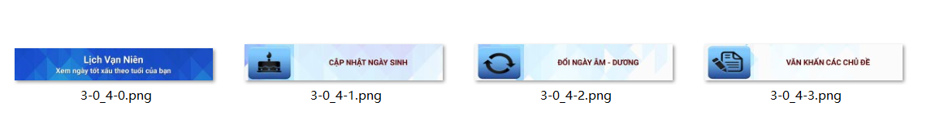

Slide 16
Q:
1. Different layers of the Dom Tree of each GUI.
2. The nodes with the same bounds have different class(View or FrameLayout).
3. After cutting off all the nodes with the duplicate bounds, it is hard to find the correct father of all leaf nodes.

Slide 17
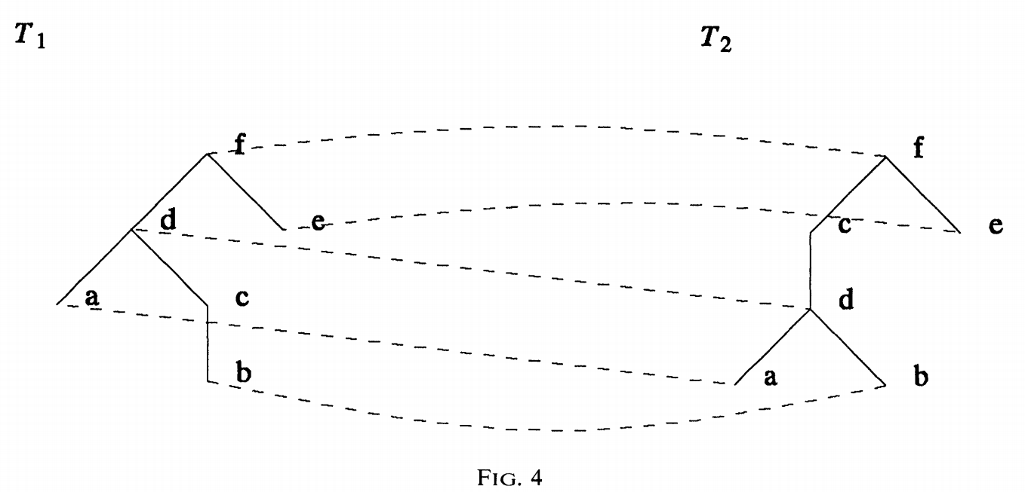

Slide 18
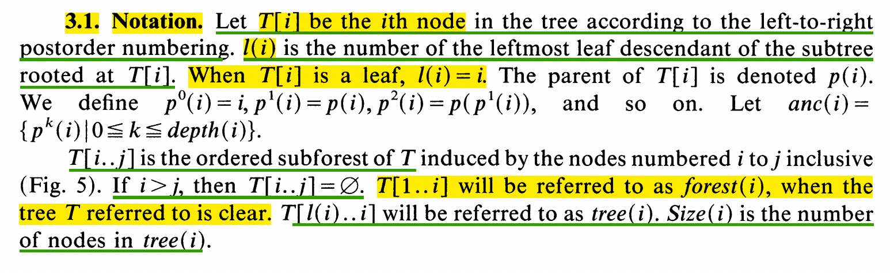
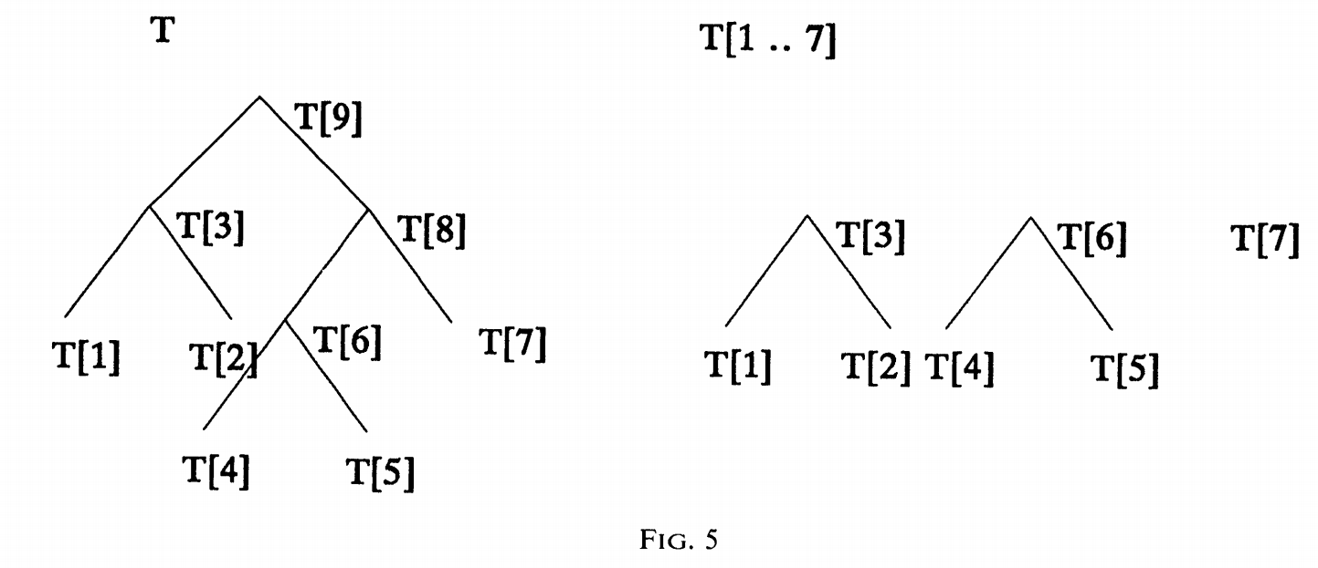

Slide 19
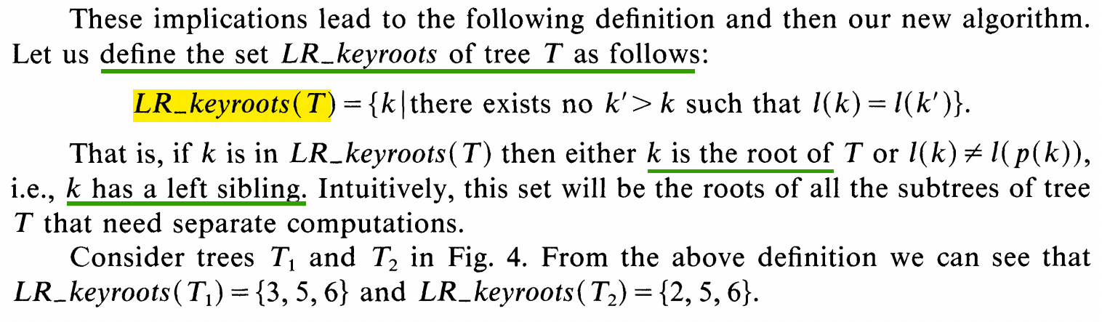

Slide 20
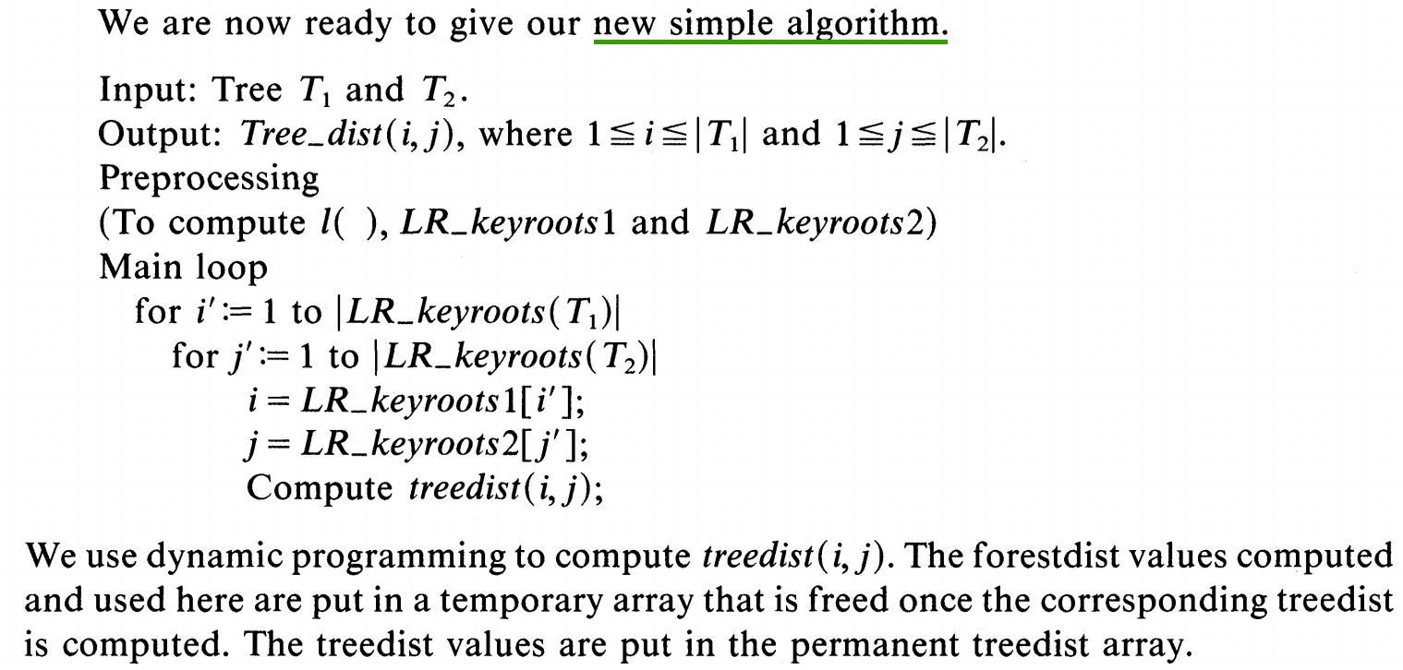

Slide 21
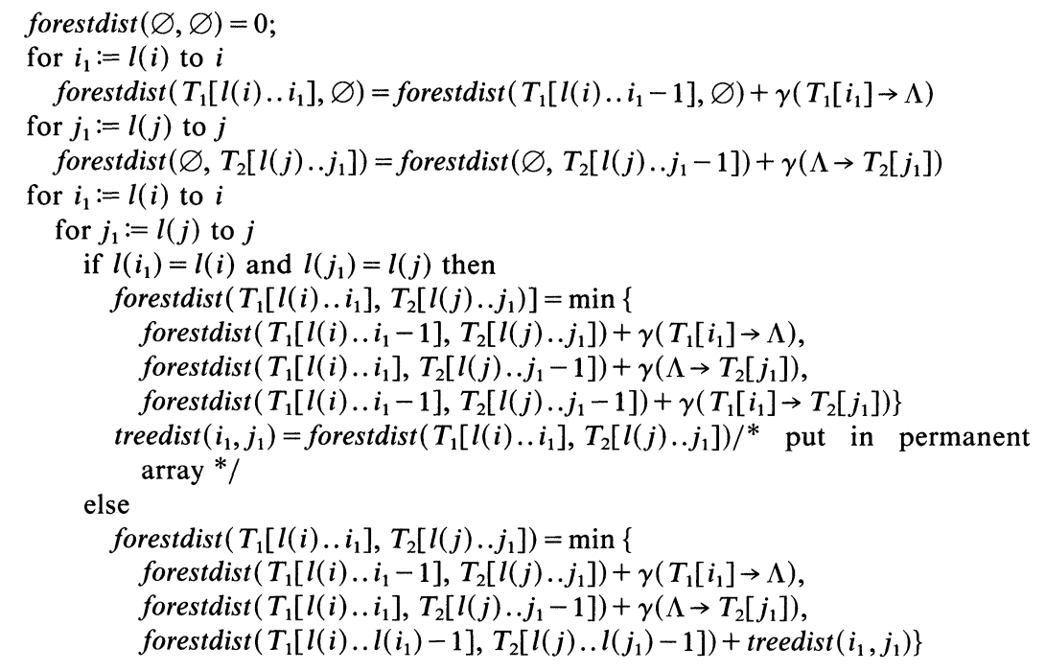
The computation of treedist(i,j):

Slide 22
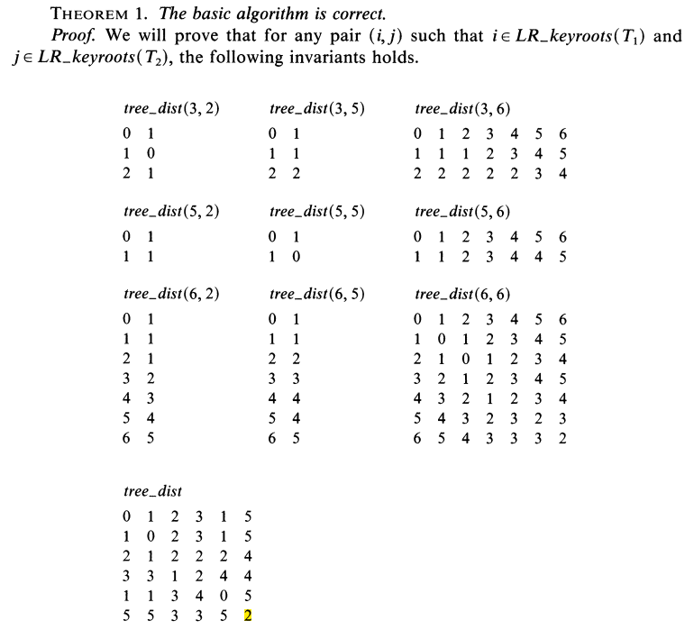

Slide 23
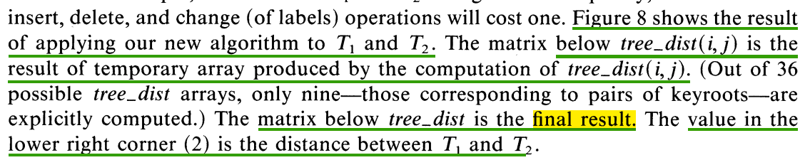
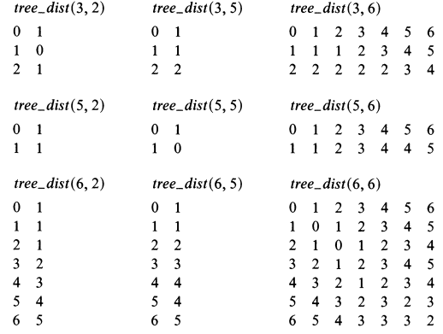
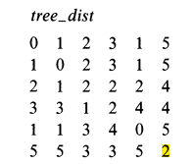

Slide 24
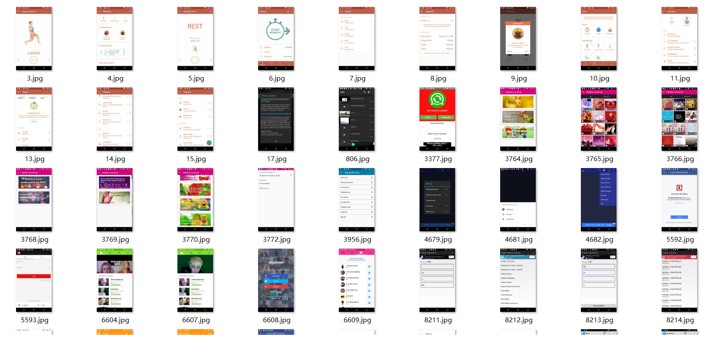
Professional：

Slide 25
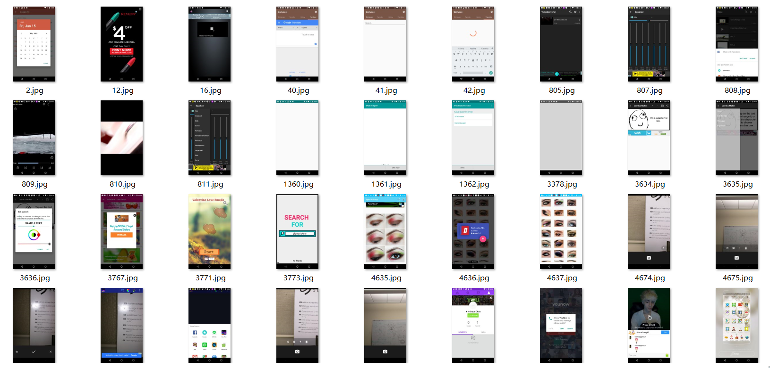
Unprofessional：

